Slide 1
Topic 1 – Numbers & Algebra
Standard 1.3 – Expressing number in the form a × 10^{k} where 1≤a<10 and k € Z.
  Operations with numbers expressed in the form a × 10^{k} where 1≤a<10 and k € Z
Standard 1.4 - SI (Système International) and other basic units of measurement: for example, gram (g), metre (m), second (s), litre (l), metre per second (m/s^{–1}), Celsius and Fahrenheit scales.

Slide 2
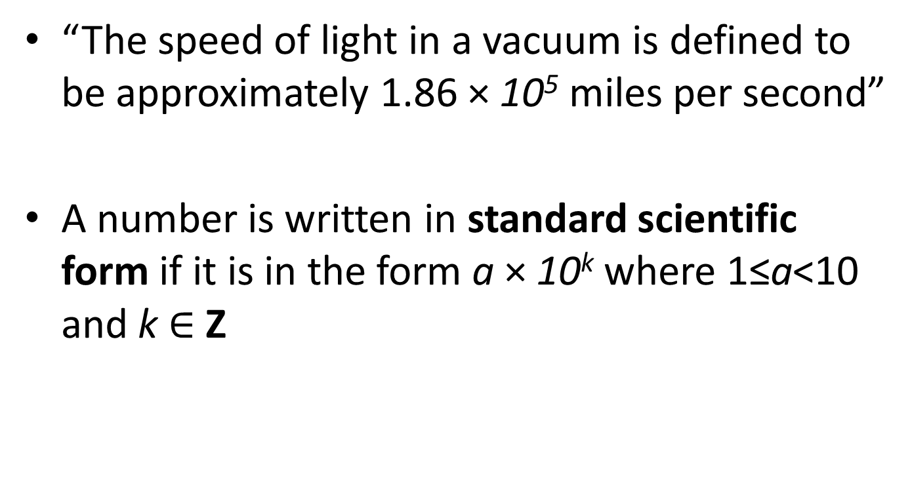
Scientific Notation – Standard Form
“The speed of light in a vacuum is defined to be approximately 1.86 × 10⁵ miles per second”
A number is written in standard scientific form if it is in the form a × 10^{k} where 1≤a<10 and k $∈$ Z

Slide 3
Scientific Notation (cont.)
Some of these numbers are not in scientific notation. Which ones? Explain.
  9.4 x 10⁻³
  2.30 x 10^{0.5}
  2.54
  12.5 x 10⁴
  6.89 x 10⁻¹⁹
  10⁻⁶
Not in Scientific Notation:
d. → b/c 12.5 ≥ 10
b. → b/c 0.5 is not an Z
Special Cases:
c. → 2.54 = 2.54 x 10⁰
f. → 10⁻⁶ = 1 x 10⁻⁶

Slide 4
Instructions for writing in S.N.
Write down a (the #): write all the significant figures of the number and place the decimal point immediately after the first significant figure.
Find k
  Moving the decimal point 11 places to the right is equivalent to multiplying by 10⁻¹¹
  Likewise, moving the decimal point 11 places to the left is equivalent to multiplying by 10¹¹

Slide 5
Examples
These numbers are given in regular form. Write them in standard form.
  546,000,000,000
  0.003242
→ 5.46 x 10¹¹
→ 3.242 x 10⁻³

Slide 6
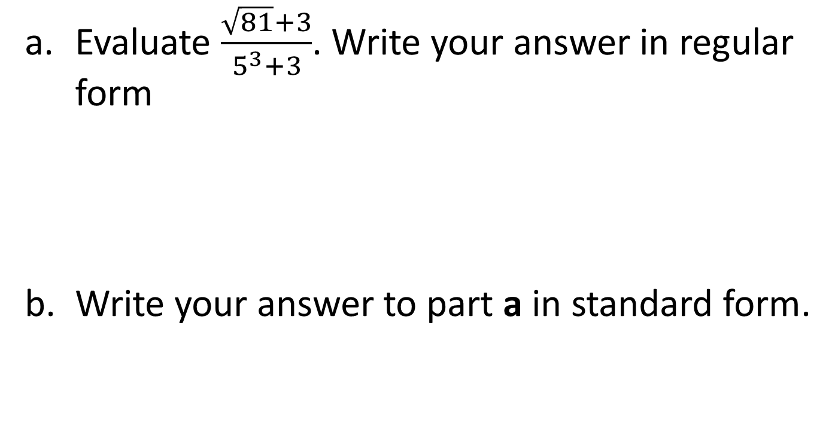
More Examples
Evaluate $\frac{\sqrt{81}+3}{5^{3}+3}$. Write your answer in regular form
Write your answer to part a in standard form.
Solution = 0.09375
Solution = 9.375 x 10⁻²

Slide 7
Operations with number in Scientific Form
Let x = 3.24 x 10⁴ and y = 8.32 x 10⁶.
  Evaluate x + 2y
  Write your answer to part a correct to 3 s.f.
  Give your answer to part b in scientific form
= 16672400
= 16,700,000
= 1.67 x 10⁷

Slide 8
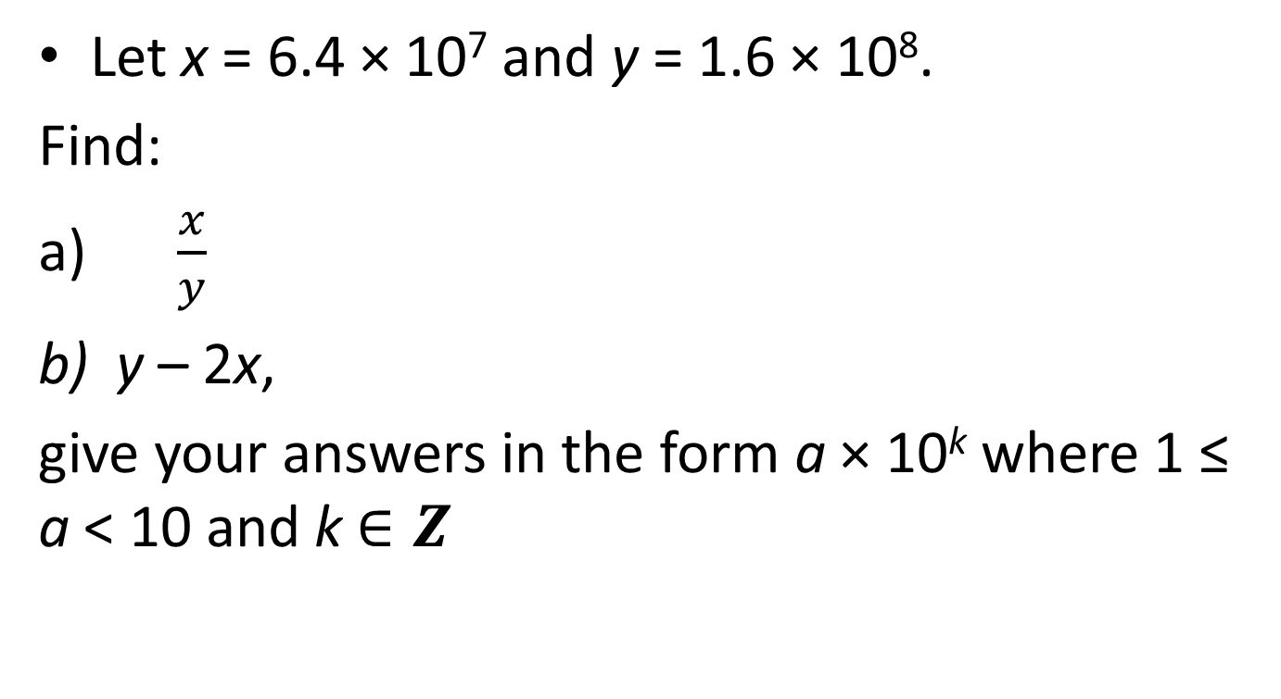
Operations with numbers in Scientific Form – Student Example
Let x = 6.4 × 10⁷ and y = 1.6 × 10⁸.
Find:
$\frac{x}{y}$
y – 2x,
give your answers in the form a × 10^{k} where 1 ≤ a < 10 and k $∈Z$
→ 4.0 × 10^{–1}
→ 3.2 × 10⁷

Slide 9
Student Example
Let x = 2.35 x 10⁴ and y = 4.86 x 10⁻³.
  Evaluate 2x + 3y.
  Write your answer to part a correct to 5 s.f.
  Give your answer to part b in scientific form
= 47000.01458
= 47,000
= 4.7 x 10⁴

Slide 10
Homework
Red book (course companion):
  Pg.70 – 71
    8 (a - f)
    13 (a & c)
    14 (c)
  Pg. 74-75
    1 (a & c)
    2 (a, b, & d)
    3
    4
    5 (b & d) Due: Thursday

Slide 11
S.I. Units
The SI is a practical system of units for international use and is founded on these seven base units:
The metre (m) for distance
The kilogram (kg) for mass
The second (s) for time
The ampere (A) for electric current
The Kelvin (K) for temperature
The mole (mol) for amount of substance
The candela (cd) for intensity of light

Slide 12
S.I. Units (cont.)
There are more units called “derived units”, that are defined in terms of the seven base units. Such examples are:
  Square metre (m²) for area
  Cubic metre (m³) for volume
  The metre per second (m/s or ms⁻¹) for speed or velocity

Slide 13
SI Units (cont.)
The speed of sound in air is given as 300 m/s⁻¹
  How many metres does sound travel in air in one hour?
  Express your answer to part (a)
    Correct to two significant figures
    in the form a × 10^{k}, where 1 ≤ a < 10 and k € Z
1, 080,000 metres per hour
1,100,000 metres
1.1 x 10⁶ metres

Slide 14
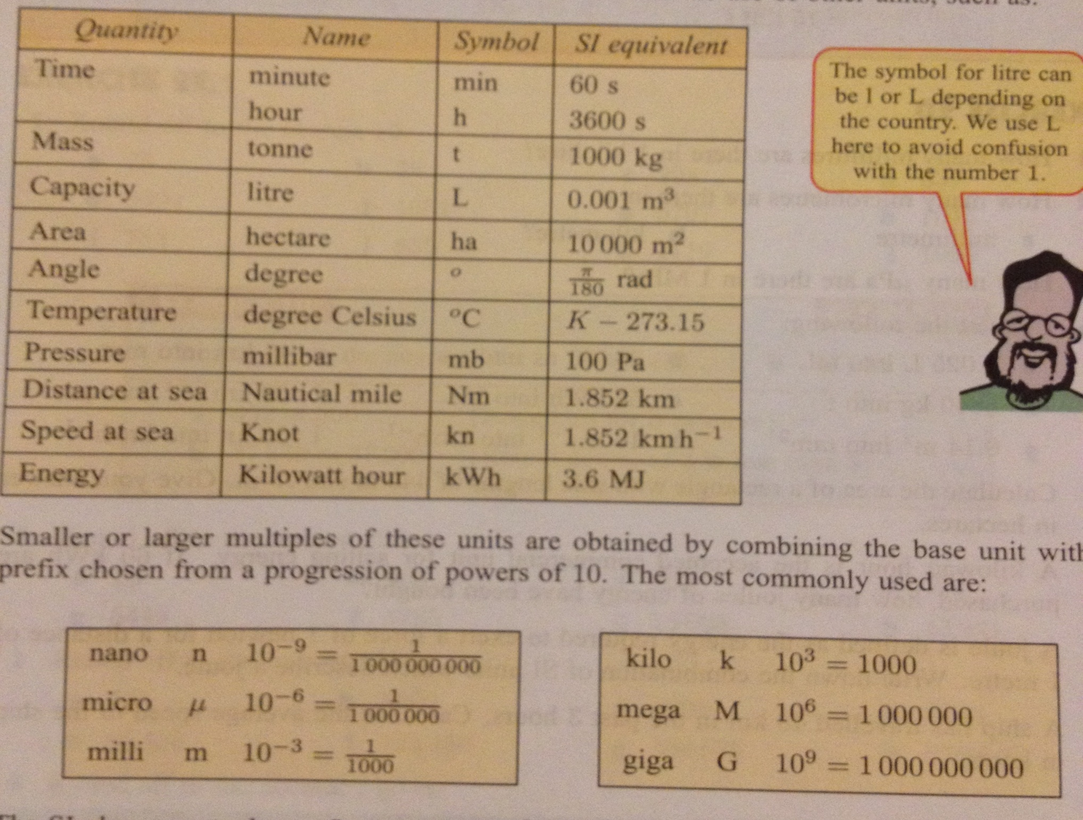

Slide 15
Examples of Converting SI Units
Convert the following to the stated unit:
  0.025 L → mL
  5840 kg → t (where t = tonne)
  25,580 ns → μs (where 1 μs = 10⁻⁶ s)
  45km → mm
= 25 mL
= 5.84 t
= 25.58 μs → 2.558 x 10¹ μs
= 4.5 x 10⁷ mm

Slide 16
Converting Between SI Units
Convert 0.006491 millimetres to metres
  Give your answer correct to two significant figures
  Give your answer to part a in standard form
0.0000065 m
6.5 x 10⁻⁶ m

Slide 17
Converting between SI Units (cont)
Convert 2 days 9 hours & 12 mins to seconds:
  1 day = 86,400 s → 2 days = 172,800 secs
  1 hour = 3600 secs → 9 h = 32,400 secs
  1 min = 60 secs →12 mins = 720 secs
  So, 172,800 + 32,400 + 720 = 205,920 secs

Slide 18
Celsius ←→ Fahrenheit
Below is the comparison scale between common temperature systems:

Slide 19
Formulas for Temp Conversion
Calculating Temps from ◦F to ◦C.
  T_{f} = (9/5)t_{c} + 32
  T_{c} = (5/9)(T_{f} – 32)

Slide 20
Homework
Pg. 80 (Red book)
  1 (a)
  3(b & c)
  5(a & c)
  7(a & b)
  12

Slide 21
Homework
Red book (course companion)
  Pg. 74-75
    1 (a & c)
    2 (a, b, & d)
    3
    4
    5 (b & d)
    6 (a, b, d, e) {new addition for Tuesday/Thursday class}
  Pg. 80 (Red book)
    1 (a), 3(b & c), 5(a & c), 7(a & b)

