Slide 1
Differential Calculus
7.1 Concept of the derivative as a rate of change.
Tangent to a curve

Slide 2
Example Problem

Slide 3
Rates of Change
Rate: is a comparison of two quantities of different kinds
For example:

Slide 4
Group Activity
Turn to page 560-561 in ORANGE BOOK and complete the following activities as a group:
Ex. 20A.1
“Investigation 1 – Constant and Variable Rates of Change”

Slide 5
Average Rates of Change
If the graph is a straight line, then the rate of change is the slope of the line. This is a constant rate of change
If the graph is a curve, then we can find the average rate of change between two points by finding the slope of the chord, or line segment between them

Slide 6
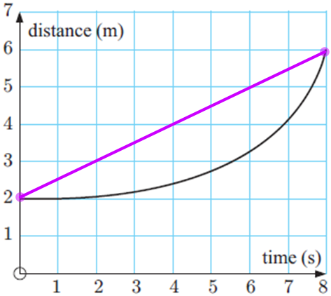
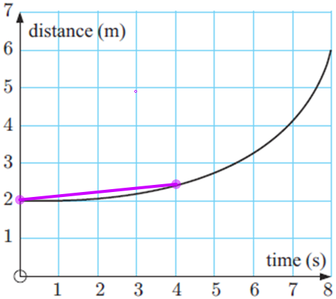
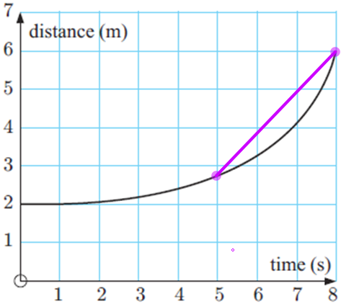
Example (Avg Rates of Change)

Slide 7
Continuing Group Activity
Turn to page 563 and complete:
Ex. 20A.2 (#’s 1 & 2)

Slide 8
Instantaneous Rates of Change – Computer Lab Activitiy
Do 7 or 8 of you guys have your books with you?
If so, check the very back to see if the CD is in your book
If we have enough to work in pairs, then I want us to go to the Math Computer Lab, and complete:
Investigation 2 – Instantaneous Speed

Slide 9
The Derivative Function
To illustrate the algebraic method we will once again consider the curve $y=x^{2}$ and the tangent at F(1, 1).
Let the moving point M have x-coordinate $1−h$, where $h≠0$.
So, M is at $(1+h, {\left(1+h\right)}^{2})$

Slide 10
The Derivative Function (cont.)
We are trying to find the gradient of the curve at the point F (1, 1).
The gradient of the chord FM is:

Slide 11
The derivative function (cont.)
Now, as M approaches F, h approaches 0, and so $2+h$ approaches 2
Since the gradient of the chord FM gets closer and closer to 2, then we conclude:
The gradient at point (1, 1) is 2
Therefore, the tangent at point (1, 1) has a gradient of 2

Slide 12
The Derivative Function – Example #1
Use the algebraic method to find the gradient of the tangent to $y=x^{2}$ at the point where $x=2$
This time the fixed point is F(2, 4)
Because ${F\left(x, { x}^{2}\right)→2}^{2}=4$, so $F\left(2, 4\right)$
We will work out on board

Slide 13
The Derivative Function – Practice 1
Use the algebraic method to find the gradient of the tangent to:
We find the fixed point and set up the function like this:

Slide 14
Answer to Practice 1:

Slide 15
The Derivative Function – Practice 2
Use the algebraic method to find the gradient of the tangent to:
We find the fixed point and set up the function like this:

Slide 16
The Derivative Function – Practice 2

Slide 17
The Derivative Function – Practice 3

Slide 18
Homework
Pg. 565 Ex. 20B.1
(1 & 2 all)
Pg. 568 Ex 20B.2
[1 (b,c,e), 2 (all), & 3 (all)]

