Slide 1
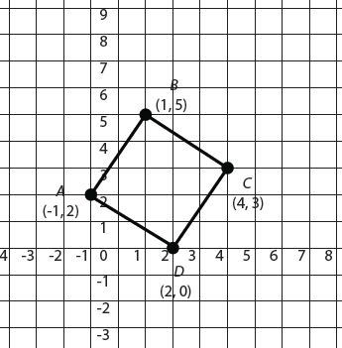
Warmup 11-6-13

Slide 2
Coordinate Geometry
Subtopics:
Distance between two points
Midpoints
Slope of lines
Parallel & Perpendicular lines

Slide 3
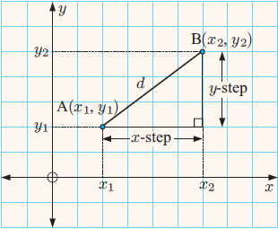
Distance between two Points
The distance formula is a formula used to find the distance between any two points on the Cartesian coordinate system (xy-plane)
$d=\sqrt{{(x_{2}−x_{1})}^{2}+({y_{2}−y_{1})}^{2}}$
Where $x_{2},x_{1},y_{2},\&y_{1}$ are coordinate values of your points

Slide 4
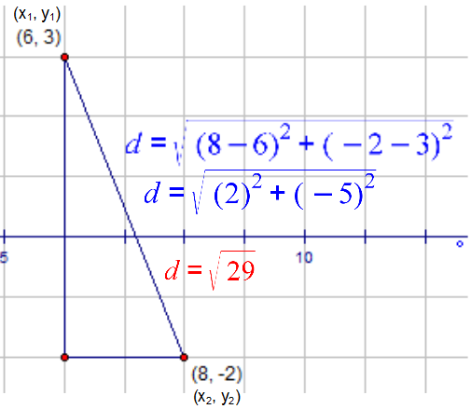
Distance Formula

Slide 5
Find the distance between these points
$d=\sqrt{10}$ units
$d=\sqrt{13}$ units

Slide 6
Using the distance formula…
First of all, let’s review what “a” is talking about:
Equilateral: all sides of a triangle are congruent
Isosceles: two sides of a triangle are congruent
Scalene: none of the sides of a triangle are congruent.

Slide 7
Using the distance formula (cont.)…

Slide 8
The converse of Pythagoras' Theorem
The converse states that whenever the sum of the squares of two sides equal to the square of the third side of the triangle, the triangle is a right triangle

Slide 9
Using the distance formula…
We will do these on the board:

Slide 10
Midpoint Formula
This formula is used to find the exact halfway point between two points in question:
$MP=\left(\frac{x_{1}+x_{2}}{2},\frac{y_{1}+y_{2}}{2}\right)$
Where $x_{2},x_{1},y_{2},\&y_{1}$ are coordinate values of your points

Slide 11
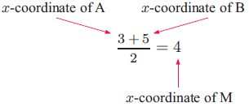
Midpoint Example:

Slide 12
Midpoint Example #2
We will do example “a” on the board:
Take a minute and find the midpoint to “b”

Slide 13
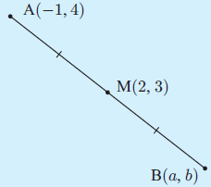
Midpoint Example #3
We will do this one on the board:

Slide 14
Alternate way to use midpoint to find other endpoint:

Slide 15
Gradient (slope)
Gradient: the measure of a line’s steepness.
Determining the slope of a line on a graph, we need to choose two distinct points.
We will find the vertical difference (y-values) and the horizontal difference (x-values) to determine the gradient:

Slide 16
Gradient (cont.)

Slide 17
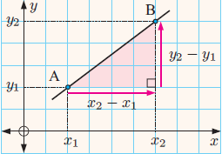
Gradient Formula:
There is a formula for determining the gradient:

Slide 18
Example #1 (using gradient formula)

Slide 19
Example #2 (using gradient formula)

Slide 20
Parallel & Perpendicular Lines
Lines that are parallel have the same slope, and different y-intercepts
For example:
If a line has a gradient of $\frac{2}{5}$, find the gradients of all lines that are:
Parallel to that line
Perpendicular to that line

Slide 21
Example
Find t given that the line joining A(1, 4) & B(5, t) is perpendicular to a line with a gradient of $\frac{2}{3}.$

Slide 22
Homework
In your ORANGE BOOK
Pg. 378 Ex. 13A [2 & 5 (all)]
Pg.381 Ex. 13B [3 (c-f only), 4 (a-c only), 7, 8, & 11]
Pg. 385 Ex. 13C.1 [1 (all)]
Pg. 387 Ex 13C.2 [1 (a-c), 3 (a-c)]
Pg. 390 Ex. 13D [3, 4, 5, 6]
Pg. 391-392 Ex. 13E [1 & 6 only]

Slide 23
Vertical and Horizontal Lines
All vertical lines have:
equations in the form $x=a$ where $a$ is a constant, and
the gradient is undefined
All horizontal lines have:
Equations in the form $y=b$ where $b$ is a constant, and
The gradient is zero

Slide 24
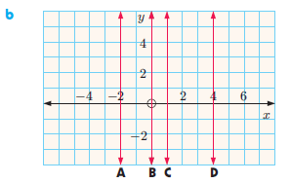
Vertical and Horizontal Lines
$$A) y=−3$$
$$B) y=−1$$
$$C) y=0$$
$$D) y=4$$
$$A) x=−2$$
$$B) x=0$$
$$C) x=1$$
$$D) x=4$$

Slide 25
Vertical & Horizontal Lines

Slide 26
Gradient-Intercept Form
A line with a gradient m and gradient-intercept “c” has the equation: $y=mx+c$
We have learned how to determine the gradient of a graphed line and using 2 coordinates
So, we can build the equation of a line by:
Determining the gradient and substituting it in for m
Then, determining where the line crosses the y-axis (y-intercept)

Slide 27
General Form of a Line
Another way of writing the equation of a line is in the general form: $ax+by+c=0$
For example:

Slide 28
Finding Equation of a Line
We can find the equation of a line if we have:
The gradient and any point on the line, or
if we have the coordinates of two distinct points on the line
For example:

Slide 29
Finding Equation of a Line
Hint: use the gradient formula

Slide 30
Find the Equation of the Line

Slide 31
Finding the Gradient from an Equation
When the equation is in gradient-intercept form, we can look at the coefficient next to the “x” for the gradient
When the equation is in another form, one method is to rearrange the equation into the gradient-intercept form
For example:

Slide 32
Finding the Gradient from an Equation (cont.)
Please turn to pg. 399, and then:
Complete #2 (a – c)

Slide 33
Does the point lie on the line?
A point lies on a line, if its coordinates satisfies the equation.
For example:

Slide 34
Does the point lie on the line? (cont.)
$\left(3\right)−2\left(4\right)−k=0$
$(3)−8−k=0$
$−5=k$

Slide 35
Graphing Lines
The easiest way to graph lines is in the gradient-intercept form:
Use the y-intercept as the start point
Then, use the gradient (rise/run) to plot the next point(s) in reference to the y-intercept
You can also graph from the general form, by graphing the x-intercept & y-intercept.

Slide 36
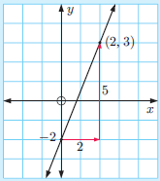
Graphing in the Gradient-Intercept Form
For example:

Slide 37
Graphing from the General Form
The easiest way when graphing from the general form, is by using the axes intercepts (x & y)

Slide 38
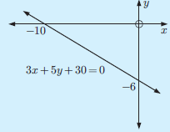
Graphing from General Form (Example)

Slide 39
Graphing Practice
Turn to pg. 401, and complete:
#1 (a, d, g)
#2 (a, d, g)
If you do not have graph paper, then draw your own graphs.

Slide 40
Homework
Pg. 394 Ex. 13F (#3 all)
Pg. 396 13G.1 (2, 4, & 6 all)
Pg. 399 13G.2 [2 (d-f), 3 (all)]
Pg. 401 13H.1 [1 (b, e, h), 2 (b, e, h)]

